Slide 1





HackOrbit 2025
SRM’s Innovators

Slide 2
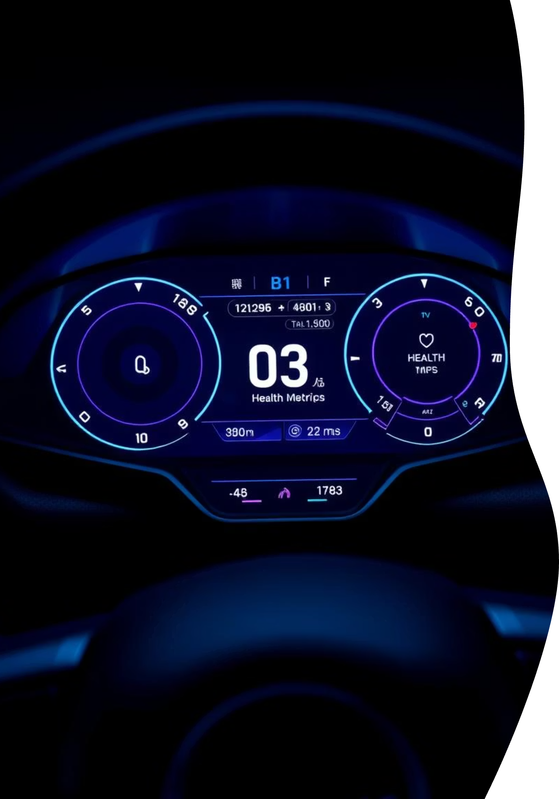
DriveGuard – Smart Car Health Monitoring & Predictive Maintenance App
Welcome to DriveGuard, your innovative solution for smart car health monitoring. This presentation outlines our vision for a predictive maintenance application, developed for the Open Innovation National Hackathon 2025.

Slide 3

Theme : Open Innovation
The Problem: Unseen Threats Under the Bonnet
Many drivers overlook subtle warnings. Hidden issues lead to costly, unexpected breakdowns.
High repair costs often stem from neglect. A lack of real-time information is the main culprit.
Advanced car diagnostics are exclusive. Only premium or connected cars offer these insights.
There is a clear market gap. An affordable, accessible monitoring system is needed.

Slide 4

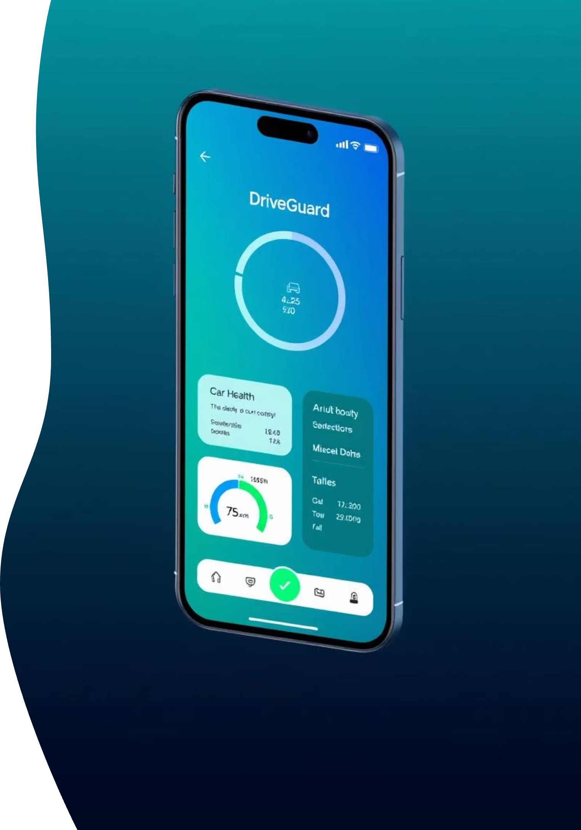

Our Solution: DriveGuard – Your Car's Guardian Angel
Real-time Parameter Analysis
Car Health Assessment
The app continuously analyses live data. It monitors parameters directly from the vehicle's system.
It evaluate car health. This ensures accurate and timely diagnostics.
Predictive Maintenance Alerts
Users receive proactive alerts. DriveGuard helps prevent failures before they occur.

Slide 5





How DriveGuard Works: A Seamless Process
Connect & Input
User logs in. Connects via OBD2 or inputs data.
Telemetry Reading
App reads fuel pressure, temperature, and voltage.
ML Model Analysis
Data goes through a model. It's trained on failure patterns.
Alert Generation
Health scores and alerts are generated. Based on thresholds and trends.
Recommendations
User gets service suggestions. Prompt action is encouraged.

Slide 6






DriveGuard's Core Features
Car Health Dashboard
Colour-coded scores and clear insights.
Live Sensor Data
From OBD2 or convenient manual input.
Predictive Alerts
AI warns of upcoming component failures.
Maintenance Reminders
Auto-scheduled based on driving patterns.
Driving Insights
Optional tips to improve vehicle performance.

Slide 7
Key Parameters We Monitor
DriveGuard reads and interprets crucial vehicle data. This can be live or user-inputted.
Our system monitors essential parameters. These include vehicle speed and fuel pressure.
Fuel trim values are analysed for efficiency. More data is gathered via OBD-II capabilities.
We also track intake air temperature. Battery voltage is closely monitored.
These values detect wear and inefficiencies. Early signs of damage are quickly identified.

Slide 8


Why DriveGuard Stands Out
Real-time car health prediction is available for any OBD2-equipped car.
AI/ML detects issues before symptoms even appear.
It's an affordable solution for non-smart vehicles.
Users gain data-driven maintenance insights, empowering them.

Slide 9
Our Team and members
SRM’s Innovators
R Nethaji
+91 8778604603
Devraj Shinde
+91 7030435112
Vighneshwaran C
+91 7845864838

Slide 10

Thank you

